Slide 1
Bringing it all together: The Global Accelerator for Paediatric Formulations (GAP-f)
Martina Penazzato (WHO) and Paul L. Domanico (CHAI)

Slide 2
Disclosure
Relations that could be relevant for the meeting | Company names
Sponsorship or refund funds | None
Payment or other financial remuneration | None
Shareholder rights | None
Other relations | None
Reference: https://www.cgr.nl/CGR.nl/media/CGR.nl/Gedragscode/Format-of-disclosure-slide-for-speakers-at-refresher-training-meetings.pdf

Slide 3
Our most vulnerable will need our help
GAP-f will make an important contribution to ensure success of Sustainable Development Goal (SDG) 3: ensure healthy lives and promote wellbeing for all at all ages:
Accelerate access to the most needed paediatric formulations for HIV and other high-burden infectious diseases in LMICs.
Will help reduce child mortality and end AIDS and combat other communicable diseases.
The best drugs or dosage formulations are NOT AVAILABLE to treat children.
Clinical evidence is lacking to define appropriate pediatric doses.
Pediatric formulations do not exist for most drugs.
Time to market (product development and uptake) lags adult products by over a decade!
GAP-f plans to cover all infectious diseases and use lessons learned in HIV. GAP-f efforts on HIV pediatric drugs will be used as Proof of Concept.

Slide 4
Formal collaboration across sectors to ensure accelerated development and uptake
A collaboration platform supported by an innovative financing mechanism that promotes a faster, more efficient and more focused approach to paediatric clinical and formulation development and introduction.

Slide 5
GAP-f Objectives
Establish relationships with key donors to support entire product lifecycle.
Create and maintain a product portfolio that addresses treatment needs
Support development of flexible and fit for purpose PIP/PSP in collaboration with innovators.
Coordinate clinical research goals .
Provide market analytics to support decisions across stages of program lifecycle.
Design, implement, and fund product commercialization plans.
Coordinate efforts between suppliers, innovators, research networks, regulators, procurers, MOH, MOF, etc.
Deploy a business model that is more efficient, sustainable, and disease agnostic.

Slide 6
Operationalizing GAP-f
Prioritizes & Evaluate
Scientific Advisory Board
Clinical Research
Deliver
Product Access
Treatment Delivery
Develop
Business Development
Product Development
Regulatory Affairs
Notes:
Prioritize product portfolio: What do we know?
Establish watching brief for new products, clinical research outcomes, evolving needs of global health
Develop an algorithm to rank opportunities against clinical, development and commercial criteria.
Communicate consistently and broadly to ensure alignment to priorities.
Generates clinical evidence that accommodates the expectations of SRAs and enables flexibility in a strategic and efficient way
Master protocol for clinical studies
Alignment of requirements and timing for PIPs and PSPs
Rapidly develops pediatric clinical trial material through contracts
Implements an aggressive strategy for product commercialization that accounts for clinical evidence, the TPP, manufacturing requirements, and market size
Draft a product commercialization plan based on available evidence that outlines risk
Launch development for those that present a viable development opportunity
Accelerates product introduction by early engagement with MOHs, primary care physicians, HCWs, and community activists
Draft product briefs, training materials and job aids
Incentivizes suppliers and coordinates procurement to catalyze uptake
Tech transfer support, development funding, market intelligence, catalytic procurement

Slide 7
Purpose-Built Mixed Funding model
Unitaid
NIH
Industry
EU
PEPFAR
Gates
Prioritization
Uptake
The goal is to develop an innovative but coordinated funding mechanism that leverage both public and private investments

Slide 8
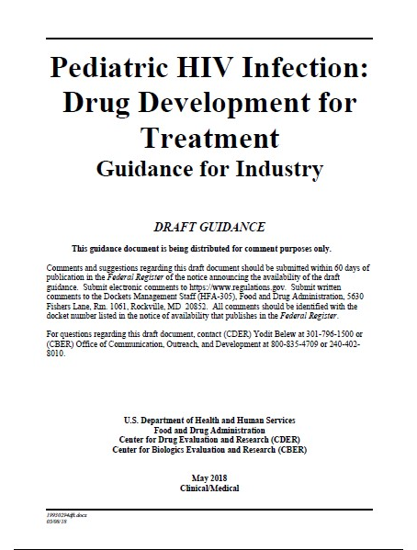
GAP-f is already delivering
Providing guidance on how to accelerate R&D for paediatric ARVs
Advocating and enabling simplification of regulatory frameworks

Slide 9
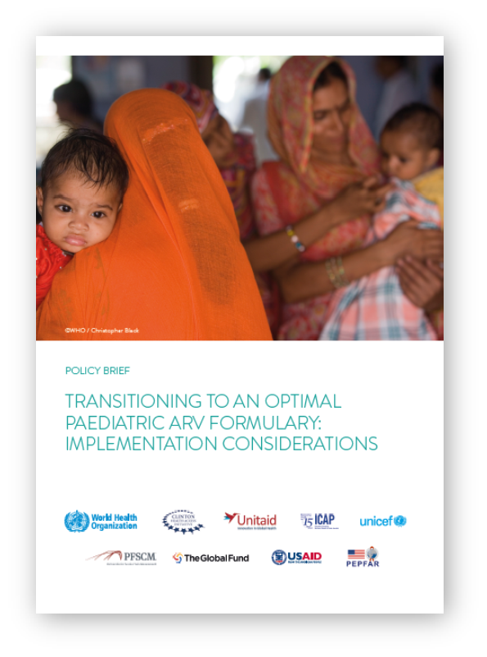
And accelerating existing work…
Guiding product selection aligned with Global Guidelines
Supporting programmes to transition to optimal regimens

Slide 10
Next Steps
A business plan will be finalized later this year.
It will clearly define how we partner, make decisions, and deliver as well as propose opportunities on new funding approaches.
We will continue discussions with our non-HIV partners to articulate the value of the GAP-f initiative.
We will reach out to industry partners to refine our plans, secure support, and most importantly to begin work to accelerate the development of new treatment options for children.
Finally, prioritization will continue based on the PADO model for HIV, and for TB and HEP by the end of the year.
Stay connect and give us your feedback!

Slide 11
THANK YOU!

Slide 12
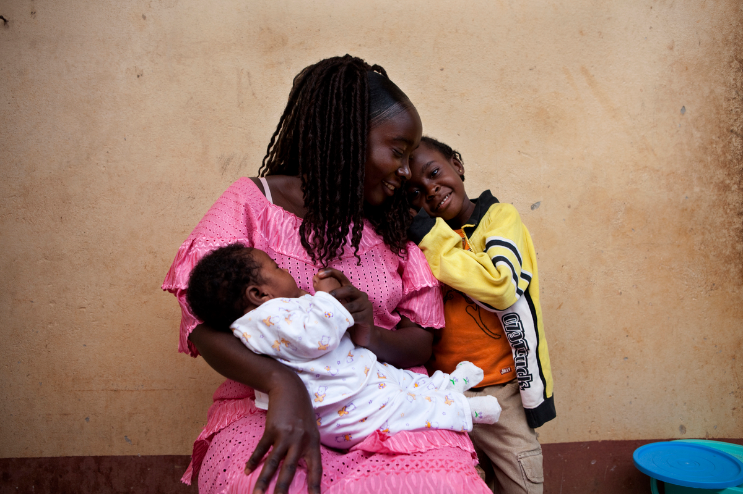
Toolkit for research and development of paediatric antiretroviral drugs and formulations
In collaboration with experts from the Paediatric Antiretroviral Working Group
Available at
http://www.who.int/hiv/pub/research-dev-toolkit-paediatric-arv-drug-formulation/en/
https://globalhealthtrainingcentre.tghn.org/research-toolkit-paediatric-antiretroviral-drug-and-formulation-development/

